Slide 1
Opinion content recommendations
Research-backed ideas for a smarter, sharper, more constrictive discussion, with our local news brands at the center

Slide 2
Research and readership analysis of our opinion content, on the whole, shows:
It’s among our least-read content, both online and in print
It’s among our least-understood content (ongoing media literacy gaps on news coverage vs. opinion content)
It is directly tied to our problems in perceived credibility, trust, objectivity, balance
It is frequently cited for stops/cancellations
Where once it was a vehicle for regularly exerting community leadership, our opinion content now is only relevant in steering/influencing policy in rare and extraordinary cases

Slide 3
Overarching theme from our research:
Readers don’t want us to tell them what to think
They’re offended that we perceive ourselves as having earned that role
They don’t believe we have the expertise to tell anyone what to think on most issues
They perceive us as having a biased agenda, which in their mind renders us unqualified to tell them what to think

Slide 4
Research shows: We do still have opportunity with opinion content
Hosting reasoned, respectful discussion on truly local issues
Highlighting expert local voices that are not the same-old talking heads and political hacks
Solutions: We can harness focus and energy behind better outcomes to key community issues
Convening: We still have the power to bring together parties, factions, alliances and other stakeholders
Taking an institutional stand in the truly extraordinary moments
Local columnists remain highly valued and trusted by readers

Slide 5
Letters and op-eds
This content, which showcases the points-of-view of ordinary community members (as opposed to our own journalists) must meet the same high standards for accuracy, truthfulness, fairness, respect. We will not run content of any kind that does not meet these fundamental standards.
Labeling something as a person’s opinion doesn’t release it from these obligations.
In particular, we see misinformation and hate speech in letters making its way all the way to the point of publication.
Defamatory, harmful, degrading and dehumanizing language has no place in our pages.
Notes:
The Tennessean won’t run anything that denies the dignity of another person. We are a place of reconciliation and constructiveness.

Slide 6
Some possible approaches for you to choose
Curtail
Curtail volume in favor of quality: Focus on opinion packages fewer days per week/month. If it isn’t a robust, high-quality package, hold it for when it is.
Narrow
Sharpened relevance: Narrow your focus to local issues only. Based on this, we are eliminating most syndicated national opinion content.
Sign
Added transparency: Sign any editorials (and, for that matter, dissents) your board chooses to write.
Steer
Conciliatory tone: Steer toward solutions/ resolutions over divisions/ conflict. Don’t be a venue for shouting and finger-pointing, but instead strive to be seen as constructive.

Slide 7
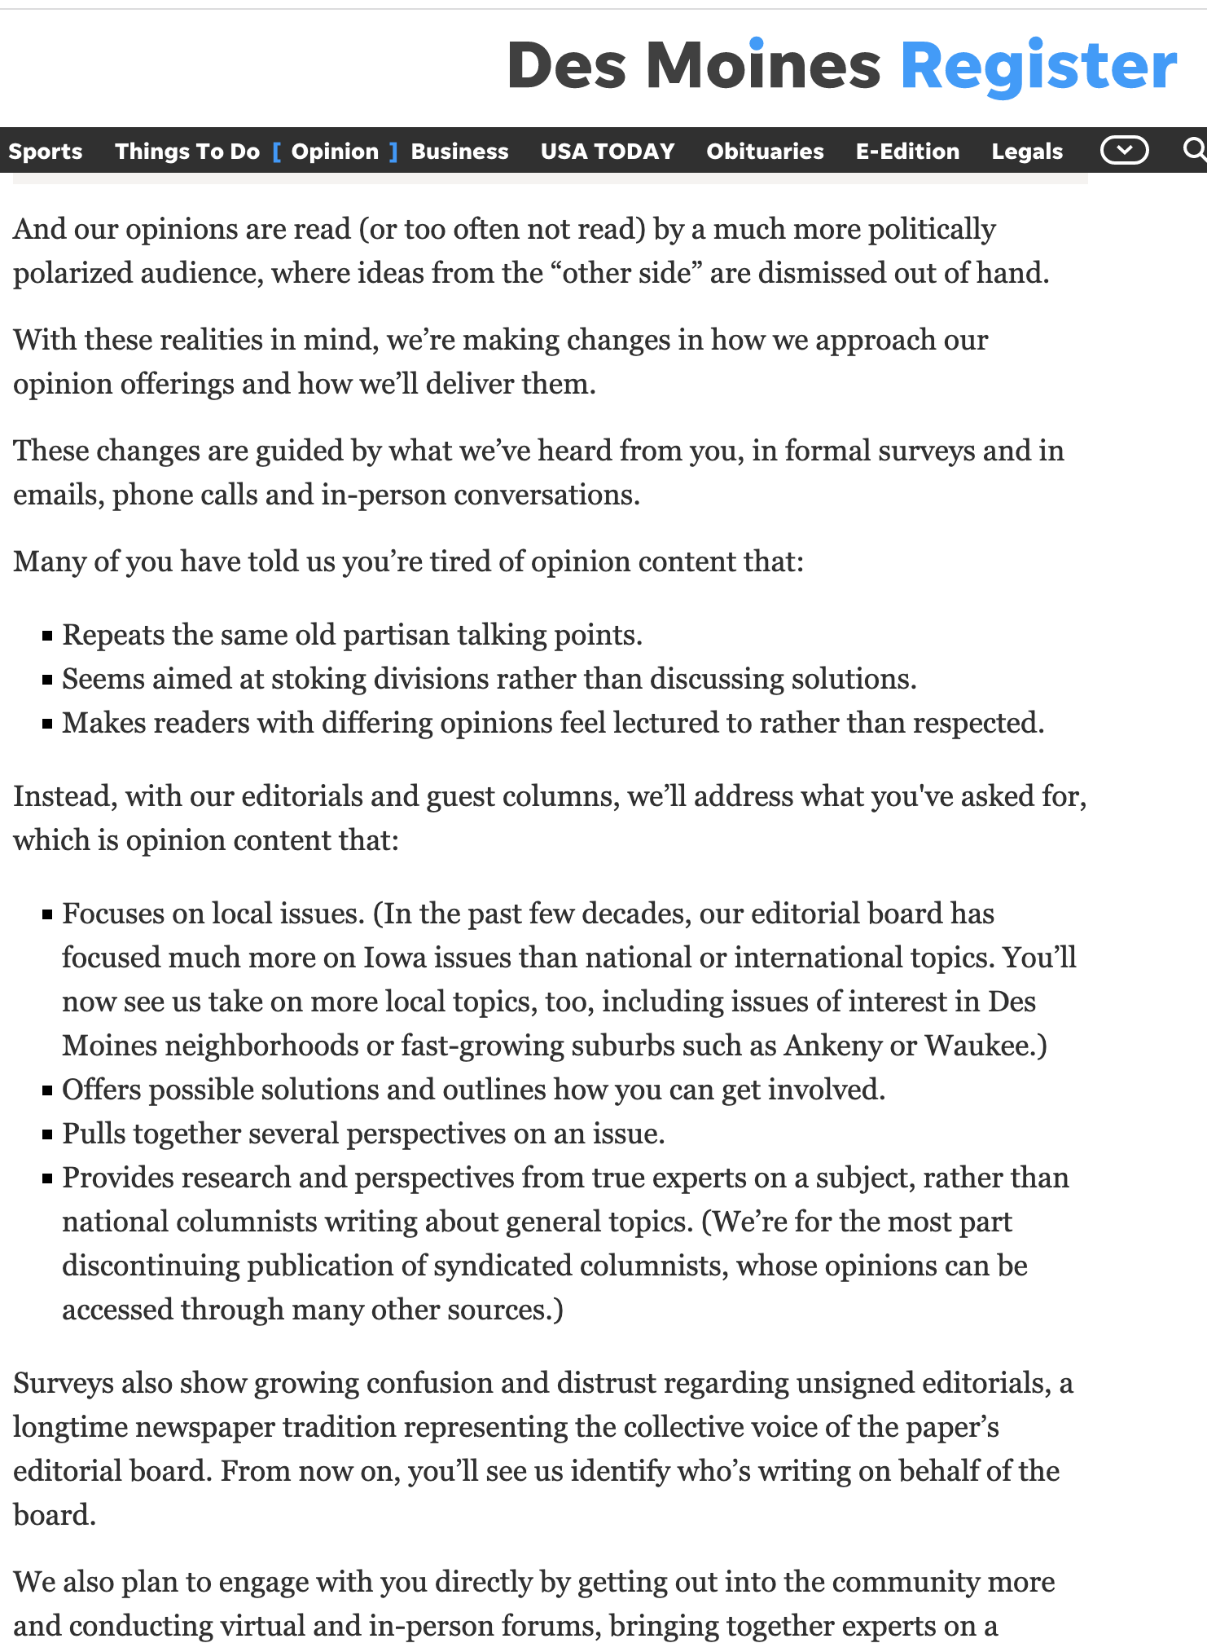
Recent changes in Des Moines
Notes:
https://www.desmoinesregister.com/story/opinion/columnists/2022/03/13/opinion-section-content-print-changes/6985888001/

Slide 8
We need to be clear on a few things
What this is | What this isn’t
Your choices in local markets, which you’ll continue to make every day | A one-time corporate mandate
The result of more than three years of research, experimentation and audience feedback | An impulsive or reactionary move
The product of analysis and work by opinion journalists from markets across the country, and across newsroom size spectrum | Hampered by too few or too-narrow points of view
Smarter, more effective opinion content | Walking away from opinion content
An opportunity to invest time, space and community leadership into other local coverage | A diminishment of the local coverage and/ or community leadership we offer
Backed by research and readership results, in print and online | A hope, based on a hunch

Slide 9
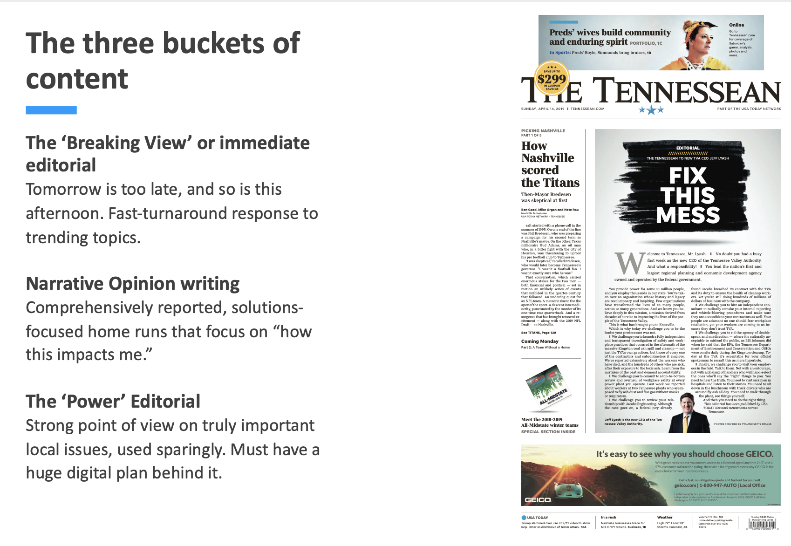
`
Notes:
2020 Tennessee press association best editorial of the year

